Slide 1
Battle of Neighborhood
Coffee Shop in Paris

Slide 2
A description of the problem and a discussion of the background
A description of the data and how it will be used to solve the problem
Methodology and Exploratory Data Analysis
Inferences and Discussion

Slide 3
Introduction and Discussion of the Business Objective and Problem
Problem:
A coffee shop owner wants to open a new coffee shop in Paris. The owner wants to analysis every data to find out best place to open shop.
Criteria
One of the criteria is to open coffee shop near restaurants.
The other criteria would be to find place densely clustered shop and restaurant areas.

Slide 4
Aim
The aim is to use owner's resources effectively by choosing correct place. This analysis provide essential data for this purpose.
Result
The results will be conveyed to owner in a simple and understandable way.

Slide 5
Data Science Methodology
Data Requirements
The data of Paris needs to be researched and a suitable useable source identified. If it is found but is not in a useable form, data wrangling and cleaning will have to be performed.
The cleansed data will then be used alongside Foursquare data, which is readily available. Foursquare location data will be leveraged to explore or compare districts around Paris, identifying the high traffic areas where consumers go for shopping, dining and entertainment and most interested in opening new stores.

Slide 6
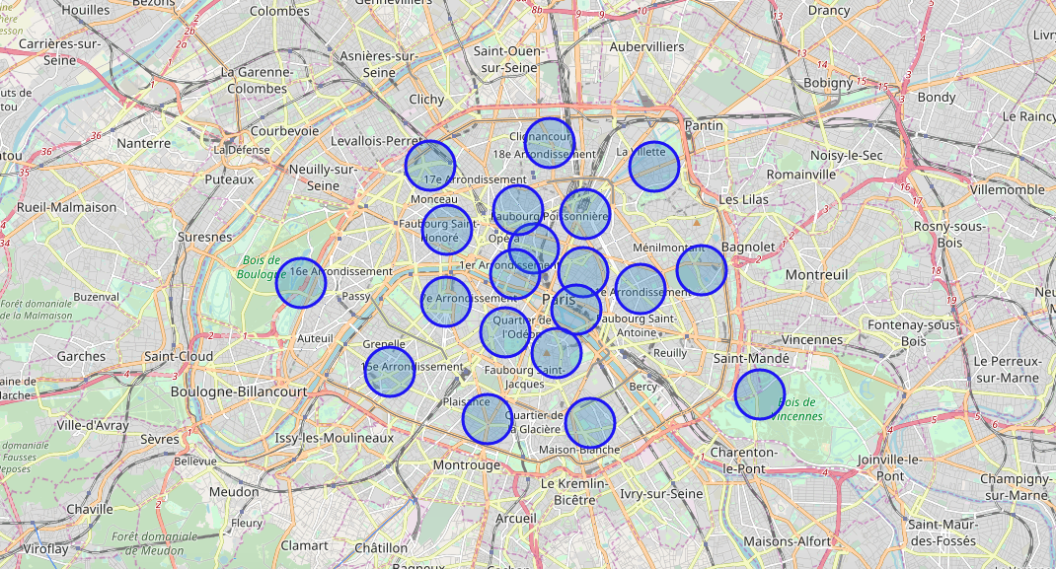
Neighborhood Locations of Paris

Slide 7
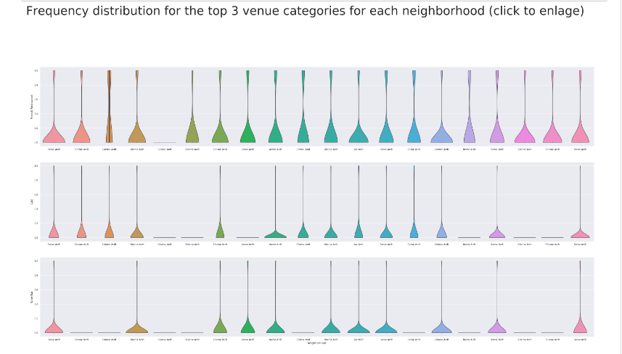

Slide 8
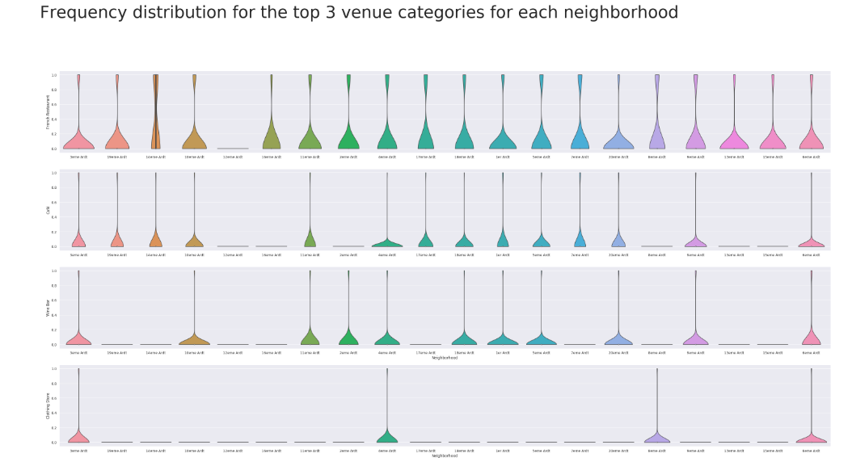

Slide 9
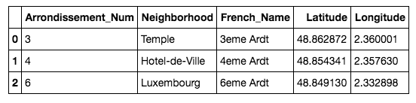
Possible Coffee Shop Locations

Slide 10
